Slide 1
CS 225 Final Project
OpenFlights: Determining Cost Efficiency
Seonggeun Cho, Jae Yoon Jeong, Jae Doo, Lenna Park

Slide 2
Goals
Calculate the approximate cost of route in terms of the frequency and distance.
Find the minimum cost path from the given source and destination.
2 Outputs:
BFS route visualization on world map.
Summary of cheaper layout flight.

Slide 3
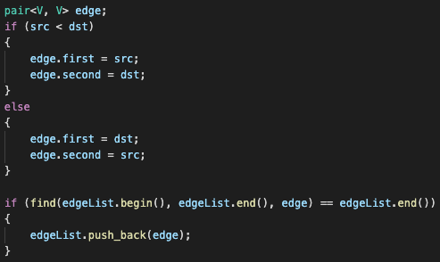
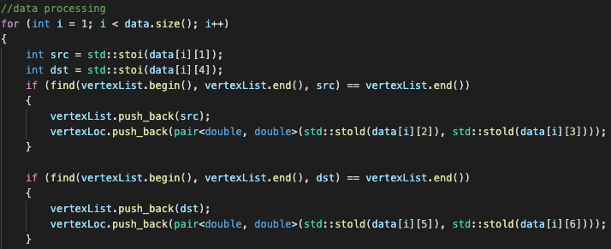
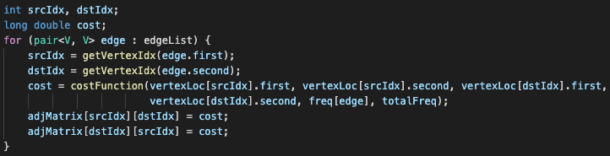
Development: Graph Implementation
Preprocessed data: src ID, src_lat, src_long, dst ID, dst_lat, dst_long
Create three Implementations:
Adjacency matrix
VertexList
EdgeList

Slide 4
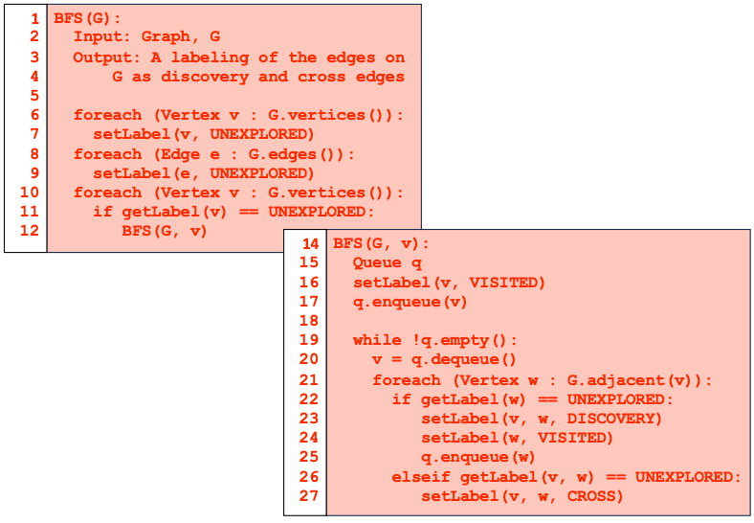
Development: BFS
Traverse over all connected vertices from the starting airport.
Based on the algorithm given in lecture.
Output: List of edges traversed indicated with DISCOVERY and CROSS.
Running time: O(m+n)

Slide 5
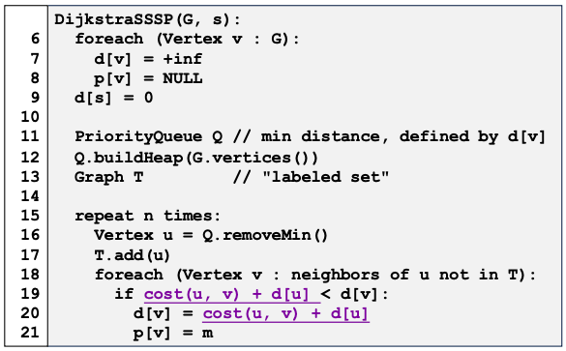
Development: Dijkstra’s Algorithm
Utilize adjacency cost matrix.
Compare between the adjacency cost and the shortest distance cost.
Adjacency cost = direct flight
Shortest distance cost = layout flight
If layout flight is cheaper than direct flight, store the route in text file.
Output: text file with layout flights cheaper than direct flight

Slide 6
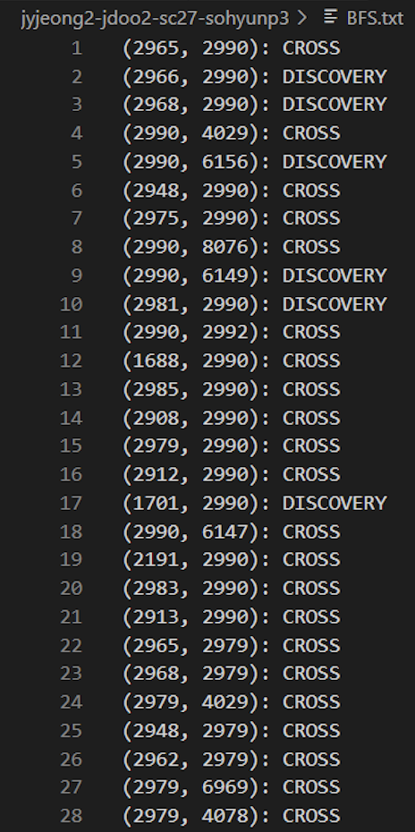
Development: Graph Visualization (BFS)
Using BFS, we printed the resulting edge list containing the shortest path from a source airport to a destination airport
The edges are printed and if they are redundant, it is labeled as CROSS and if not, it is labeled as Discovery.

Slide 7
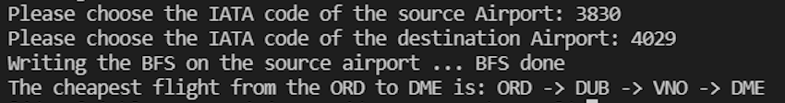
Development: Graph Visualization (Dijkstra)
For Dijkstra’s, we printed the path of the shortest path using the cost values calculated based on the distance of the flights and the frequency of the flights.
Given an input of the IATA code of the source and destination airport, the cheapest flight from the corresponding locations is printed

Slide 8
Conclusion
Successfully implemented Dijkstra’s algorithm and BFS
Faced difficulty visualizing graph as a map
However, it was a chance to utilize the knowledge and skills we have acquired throughout the semester
Efficiently applied our learning into the project
Were able to self-evaluate our ability through working on this project

